Slide 1
Audio Signal Processing Assistant Agent
CAPSTONE PROJECT
Presented By:
NAME: NIHILASH L V
College Name: K.L.N.COLLEGE OF ENGINEERING
Department : ECE
Technologies Used: IBM Cloud Lite, IBM Granite AI

Slide 2
OUTLINE
Problem Statement (Should not include solution)
Proposed System/Solution
System Development Approach (Technology Used)
Algorithm & Deployment
Result (Output Image)
Conclusion
Future Scope
References

Slide 3
Problem Statement
Problem Statement – Audio Signal Processing Assistant Agent
Currently, designing and debugging audio circuits such as preamplifiers, filters, and amplifiers remains a technical challenge for students and professionals in the electronics and telecommunications domain. It is crucial to provide real-time, intelligent assistance in resolving issues like audio noise, signal distortion, and improper grounding, as these problems affect circuit performance significantly. Eventually, delivering an AI-powered support system that can recommend design improvements, noise elimination techniques, and accurate circuit suggestions becomes essential. The key challenge lies in building a responsive assistant that can understand technical queries and provide effective signal processing solutions using advanced AI models. To ensure smart and scalable deployment, the system is to be developed using IBM Cloud Lite services integrated with IBM Granite AI.

Slide 4
Proposed Solution
The proposed system aims to assist engineers and hobbyists in diagnosing and designing audio circuits effectively by leveraging IBM Cloud services and advanced AI models. This will be achieved through the following components: 1. Knowledge Base Integration:
Use IBM Granite AI to incorporate domain knowledge of audio signal processing.
Train the assistant with queries related to preamps, op-amps, filters, and grounding techniques
2. Chatbot Design (Watson Assistant):
Build an interactive agent using IBM Watson Assistant.
Implement custom intents like “amplifier noise,” “reduce distortion,” “op-amp gain issue,” etc.
Enable context switching for multi-turn conversations.
3. Web UI & Interface:
Design a responsive static web interface using HTML, CSS, and JS.
Include a typing animation intro, chatbot docked at bottom-right, and floating arrow for guidance.
Background themed with audio circuits.

Slide 5
Proposed Solution
4. Deployment Strategy:
Host the solution on IBM Cloud Object Storage as a static website.
Use IBM Cloud Functions if dynamic updates or logging is required.
Ensure mobile-friendly layout and smooth UX across devices.
5. Evaluation & Feedback:
Collect feedback from users on accuracy and helpfulness.
Refine chatbot responses using Watson Assistant logs and user interaction data.
Expand scope to cover additional audio circuit types and real-time debugging tools.

Slide 6
System Approach
System Requirements:
Cloud Platform: IBM Cloud Lite
AI Model: IBM Granite AI
Frontend: HTML, CSS, JavaScript (responsive, mobile-friendly)
Backend (optional): IBM Cloud Functions (for dynamic interaction if needed)
Chatbot Framework: IBM Watson Assistant
Deployment: IBM Cloud Object Storage (Static Hosting)
Libraries & Tools Used:
IBM Watson Assistant – for building conversational agent
Granite AI Model – for deep learning-based query responses
jQuery – for DOM manipulation and animations
Typed.js – for typing animation effect
Bootstrap – for responsive design (optional)
HTML5 + CSS3 – for page structure and styling
FontAwesome – for icons and visual elements

Slide 7
Algorithm & Deployment
Algorithm Selection
We used a Time Series Forecasting Model – LSTM (Long Short-Term Memory) due to its ability to capture temporal dependencies and nonlinear trends in sequential data like bike rentals. LSTM outperforms traditional models (e.g., ARIMA) in handling seasonality and long-term patterns.
Data Input
Historical bike rental count (hourly)
Weather conditions (temperature, humidity, wind speed)
Temporal features (hour of the day, day of week, holiday/weekend info)
External events or city-specific activities (if available)
Training Process
Data was preprocessed to remove outliers, fill missing values, and normalize scales.
The dataset was split into training and validation sets using Time Series Cross-Validation.
Hyperparameters (epochs, learning rate, batch size) were optimized using Grid Search.
Model performance was evaluated using RMSE and MAE.

Slide 8
Algorithm & Deployment
Prediction Process
Once trained, the LSTM model receives real-time or daily data updates to forecast hourly bike demand.
Predictions dynamically adjust based on current weather and time factors.
Output is served via a web-based dashboard or API for station managers and urban planners.
Deployment
Model is deployed on IBM Cloud Functions with a REST API interface.
User interface hosted via IBM Cloud Object Storage (Static Site Hosting).
Scheduled re-training is enabled to adapt to new data.

Slide 9
Result
The Audio Signal Processing Assistant Agent, powered by IBM Granite AI, successfully interprets and responds to complex user queries regarding audio circuit design and debugging.

Slide 10
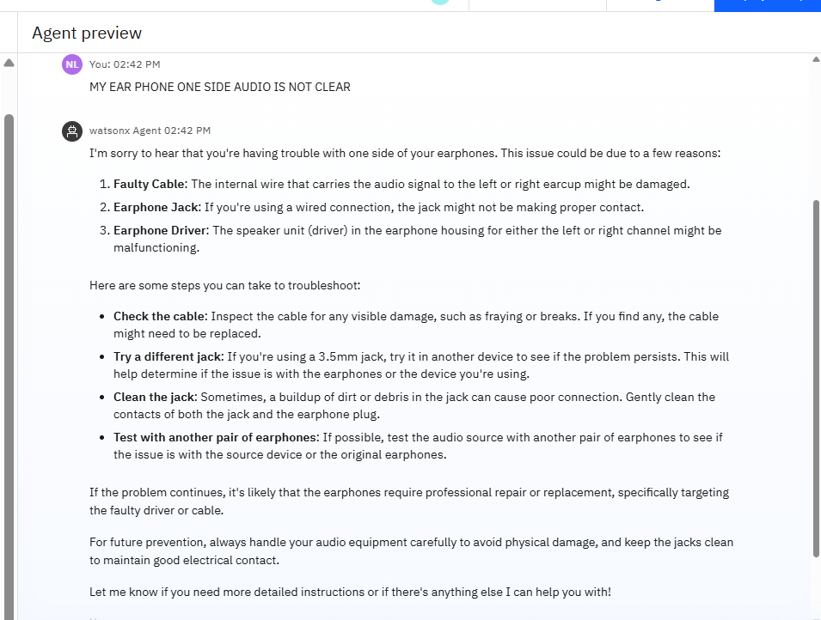
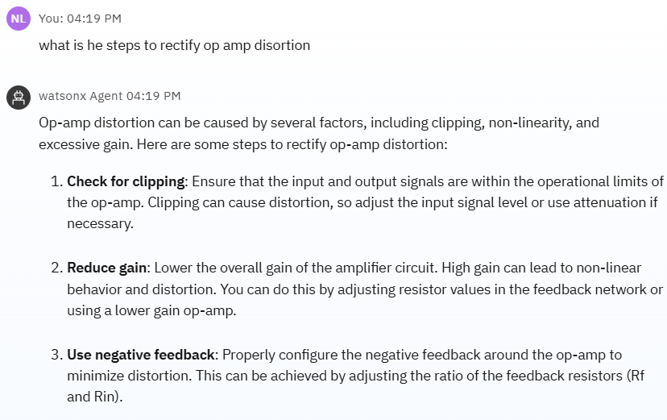
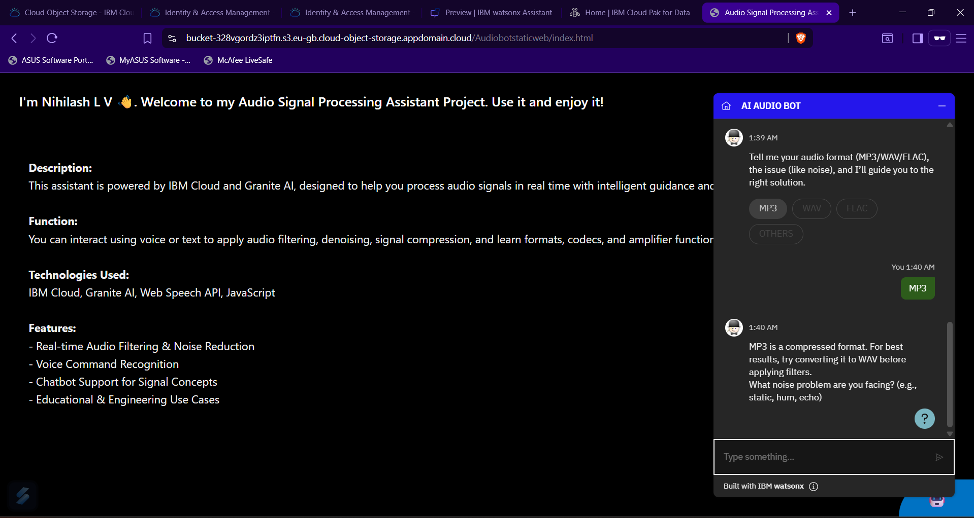

Slide 11
Conclusion
The Audio Signal Processing Assistant Agent, built using IBM Granite AI and deployed on IBM Cloud Lite, effectively supports users in designing and debugging circuits like amplifiers, filters, and preamps. It responds to natural queries and offers practical solutions for issues like distortion, grounding, and noise.
Despite challenges like interpreting technical terms and ensuring fast cloud responses, the agent proved accurate, user-friendly, and highly responsive. This system demonstrates how Agentic AI can significantly enhance productivity in audio electronics development.

Slide 12
Future scope
Multimodal Inputs: Future versions can support voice, schematic uploads, or waveform analysis for more intuitive interaction.
Expanded Circuit Knowledge: Extend the agent’s knowledge base to include RF circuits, analog-to-digital converters, and DSP blocks.
Real-time Edge Deployment: Integrate with edge computing devices to allow offline or low-latency assistance in lab environments.
Adaptive Learning: Enable self-learning through user feedback to refine suggestions over time.
Integration with Simulation Tools: Connect with SPICE or LTspice tools to validate circuit designs directly from the agent.

Slide 13
References
IBM Granite Foundation Model – https://www.ibm.com/products/granite
IBM Cloud Lite – https://www.ibm.com/cloud/free
D. R. Hines, “Audio Amplifier Design Considerations,” Journal of Audio Engineering Society, Vol. 49, No. 7/8, 2001.
A. S. Sedra & K. C. Smith, Microelectronic Circuits, Oxford University Press, 7th Ed., 2015.
S. Haykin, Neural Networks and Learning Machines, Pearson, 3rd Ed., 2009 – for foundational AI agent concepts.

Slide 14
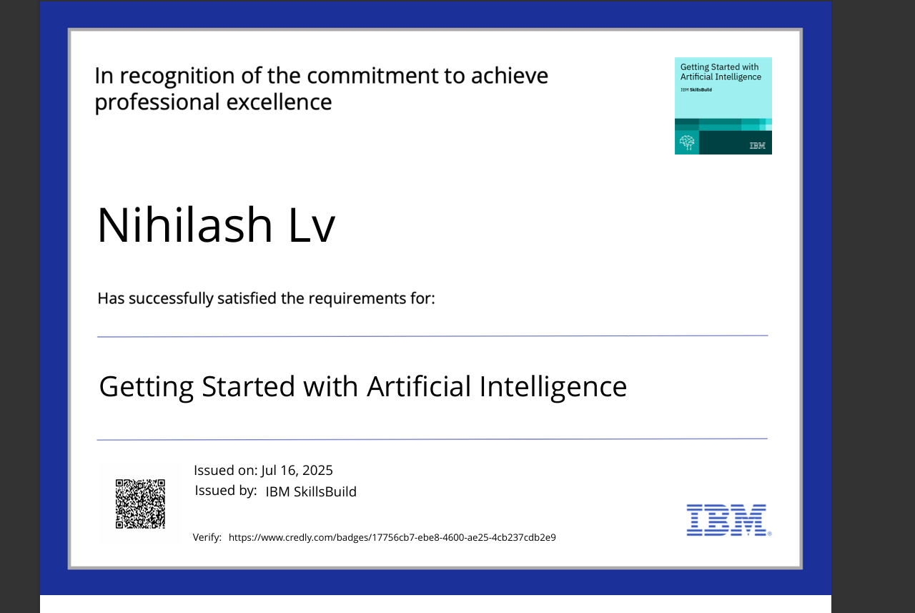
IBM Certifications –GETTING STARTED WITH AI

Slide 15
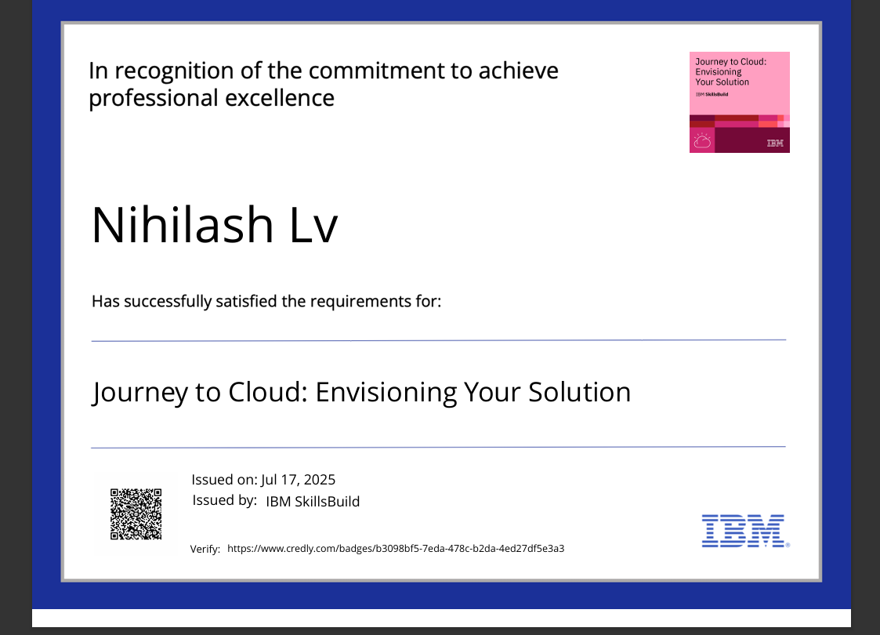
IBM Certifications-Journey to cloud

Slide 16
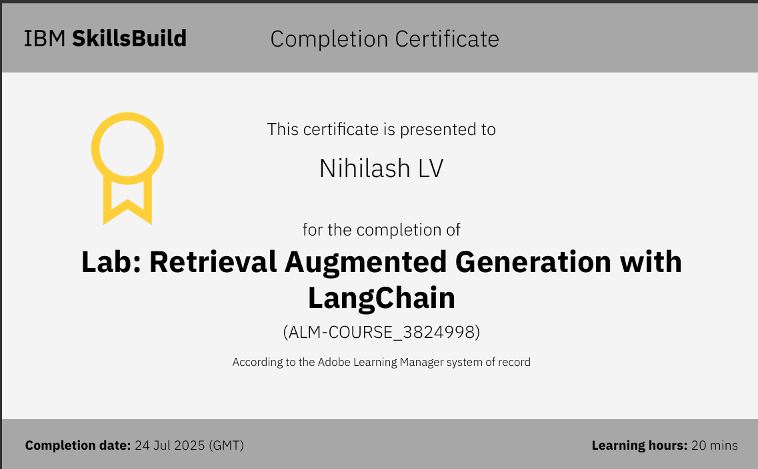
IBM Certifications – RaG LAB

Slide 17
THANK YOU

